Slide 1
Myakka River Management Coordinating Council June 22, 2012 – Englewood, Florida Presenter: Maran Hilgendorf, CHNEP
Water Atlas Overview

Slide 2
What is the Water Atlas?
A data warehouse
A set of interactive maps
A collection of tools for viewing/analyzing data
An information resource that helps citizens to understand water issues
An online venue for recruiting/organizing volunteers

Slide 3
Mission
“…to provide a comprehensive information resource that helps citizens, scientists and resource managers make informed decisions concerning our vital water resources.”
Our diverse group of users includes water managers, researchers, educators, citizen-scientist volunteers, and the general public

Slide 4
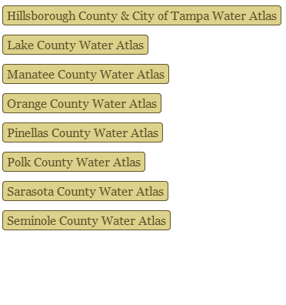
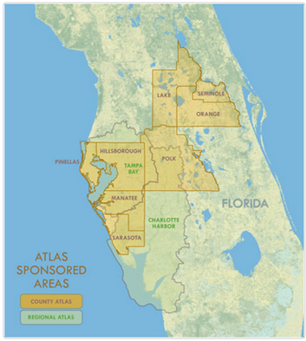
Water Atlas History
Began as a Hillsborough Atlas of Lakes in 1997
Has expanded to include…
8 County Atlases
2 Regional Atlases
1 Statewide Atlas

Slide 5
“One Atlas”
All Water Atlas sites have the same “One Atlas” structure and the same basic tools and features
Individual sites may have optional water resource types (ocean, bays, springs), volunteer page groups, special-interest pages
All sites use a common dataset and code base, with site-specific customization
All sites are reachable from all other sites, and from the gateway site WaterAtlas.org

Slide 6
Site Customization
Sarasota
Bays, Ocean
Volunteer Pages (NEST, SEA Team)
Bay Conditions
“Sarasota Captured” Photo Gallery
Oral Histories
Coastal Watershed Wiki
Tampa Bay
Bays, Ocean
Restoration Sites
Hillsborough
Bays, Ponds, Ocean
Volunteer Pages (Adopt-A-Pond, Lake Management, Stream Water Watch)
Hillsborough River Watershed Alliance
Frog Listening Network
Curriculum for Teachers
Seminole
Volunteer Pages (Macroinvertebrate Monitoring, Lake Management)
Watershed Excursion
Curriculum for Teachers
Lake
Springs
Charlotte Harbor
Bays, Ocean
Volunteer Pages (CanalWatch, CHEVWQM)
Aquatic Preserves Page
CCMP Management
Pinellas
Bays, Ponds, Ocean
Watershed Excursion
Curriculum for Teachers
Notes:
The basic site structure is augmented by page groups that address the specific conditions and concerns of each Water Atlas sponsor.

Slide 7
Atlas Organization
Data is displayed by geography and by topic
Each watershed and each water resource (lake, stream, bay, ocean, spring) has a page group with data about a group of related topics
Water resources are grouped within watersheds
Related data types are grouped on single pages

Slide 8
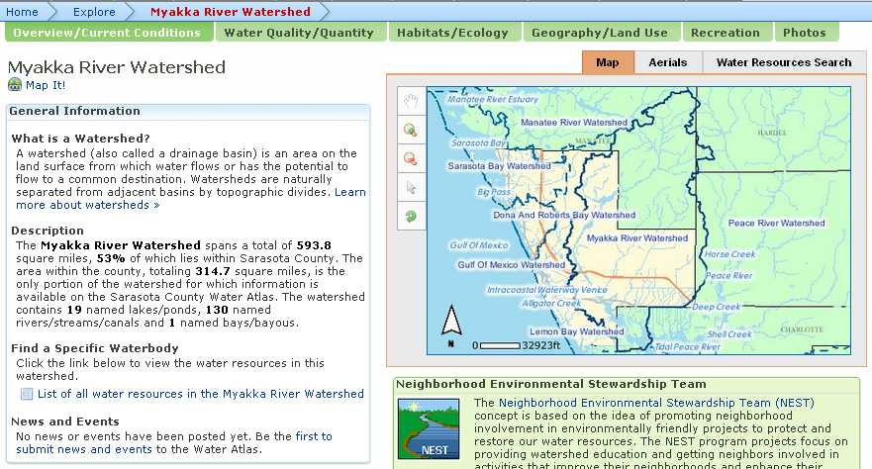
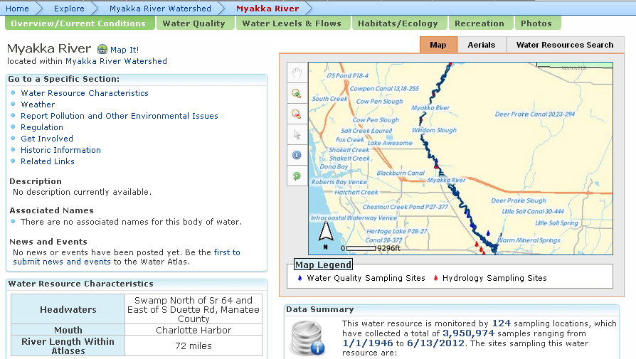
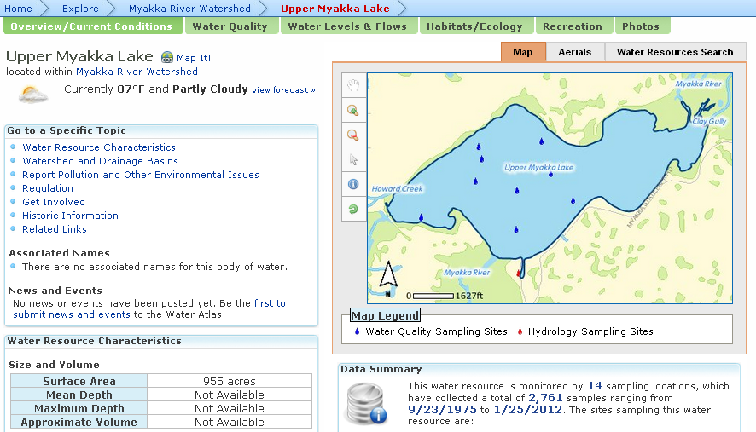
Geography
Data is organized within watersheds
Within each watershed are water resources (lakes, rivers, ponds, bays, springs, oceans)

Slide 9
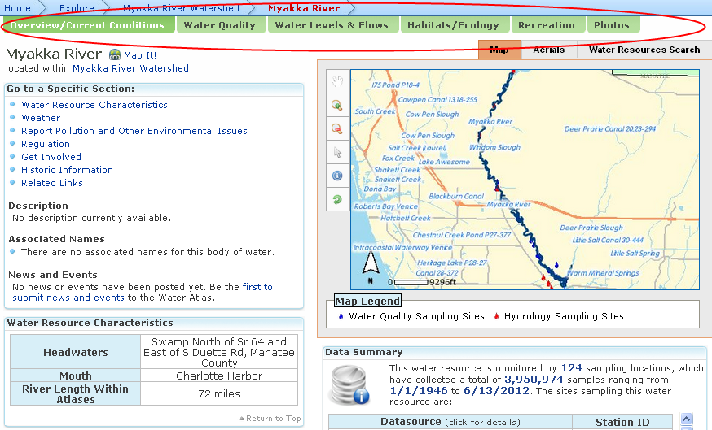
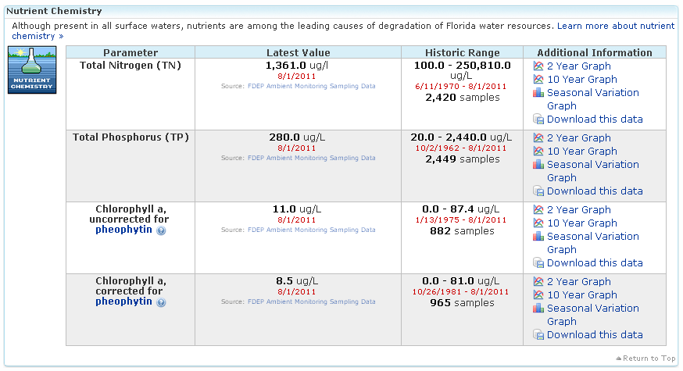
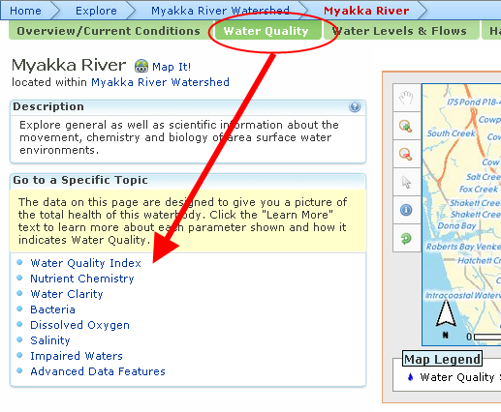
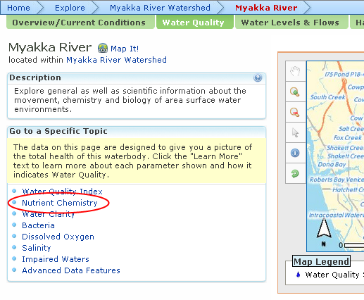
Topics
Each watershed/water body has a data-driven page group that gives information specific to its type:
Watersheds – Overview/current conditions, water quality/quantity, habitats/ecology, geography/land use, recreation, photos
Lakes/Ponds, Rivers/Streams – Overview/current conditions, water quality, water levels & flows, habitats/ecology, recreation, photos
Bays, Gulf/Ocean - Overview/current conditions, water quality, habitats/ecology, fish & wildlife, recreation, photos

Slide 10
Data Collection
SOPs established for each data provider
Most data is retrieved automatically, some manually
Total of 327+ data providers, 7,729 water resources, 37,707 sample locations, 250-million+ data samples (as of 6/10/12)
Optional, adjunct services include specialized data processing/mapping and water resource field assessments
Notes:
SOPs = Standard Operating Procedures

Slide 11
Example Information
Aerial photographs
Boat ramps & parks
Bottom contour maps
Conservation advice
Water news & events
Dynamic maps
Ecological reports
Educational curricula/links
Fishing reports
Historic & current photos
Land Use Maps
Management plans
Near real-time data
Research Reports
Vegetation Data
Volunteer Group Project Info
Water levels, flows & rainfall
Water quality data

Slide 12
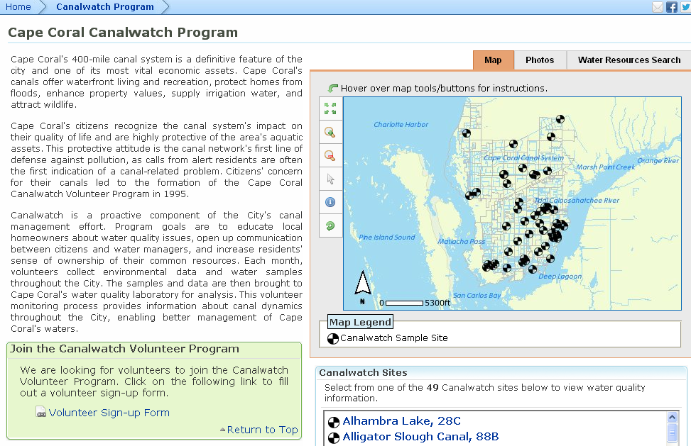
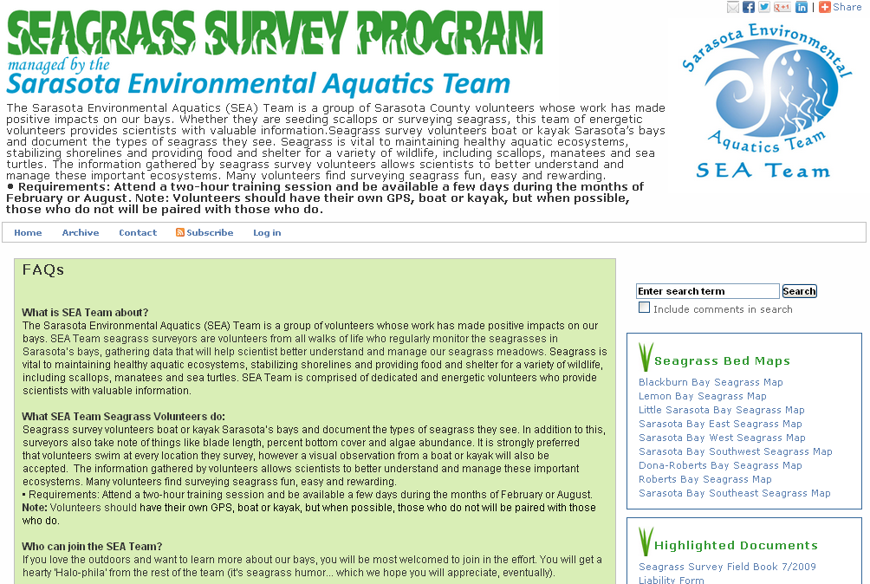
Volunteer Pages
Customized for activity:
Adopt-A-Pond (Hillsborough)
Lake Management (Hillsborough, Seminole)
Water Quality Monitoring (Charlotte Harbor Canal Watch & Water Quality Monitoring Network, Hillsborough Stream Water Watch)
Restoration Activities (Sarasota NEST)
Seagrass Surveying (Sarasota)

Slide 13
Interactive Tools
All Water Atlas sites have a core set of tools for analyzing and displaying data:
Advanced Mapper
Real-time Data Mapper
Data Download
Water Quality Contour Mapping (coastal atlases only)
Digital Library

Slide 14
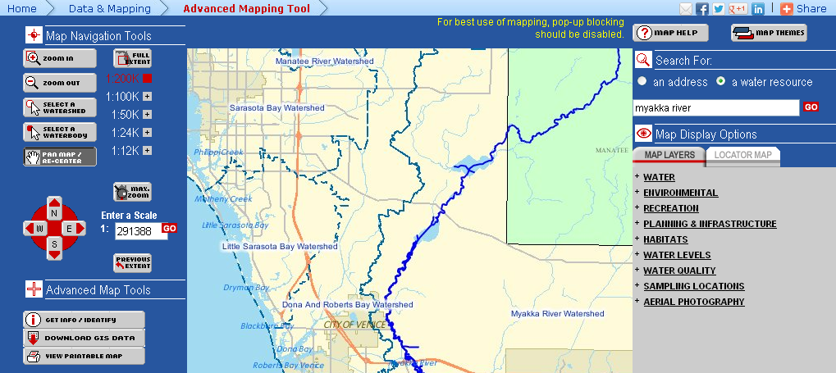
Advanced Mapper
Tool for viewing Geographic Information Systems (GIS) data
Interactive map for viewing data stored in atlas databases
GIS layers can be turned on and off
Zoom, pan, search tools allow user to select map extent
Icons, water resources link to water atlas pages, databases for accessing detailed info
Users can download GIS datasets
Users can print the custom maps that they create in several sizes

Slide 15
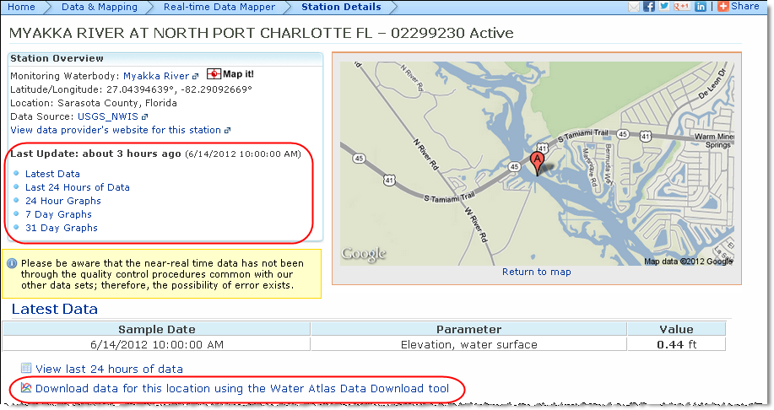
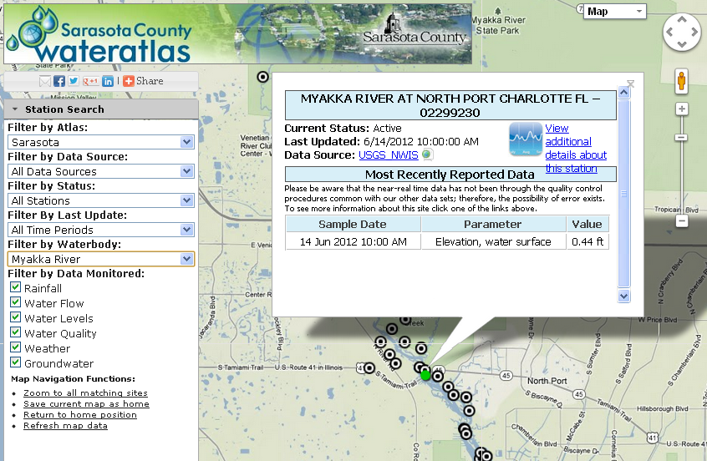
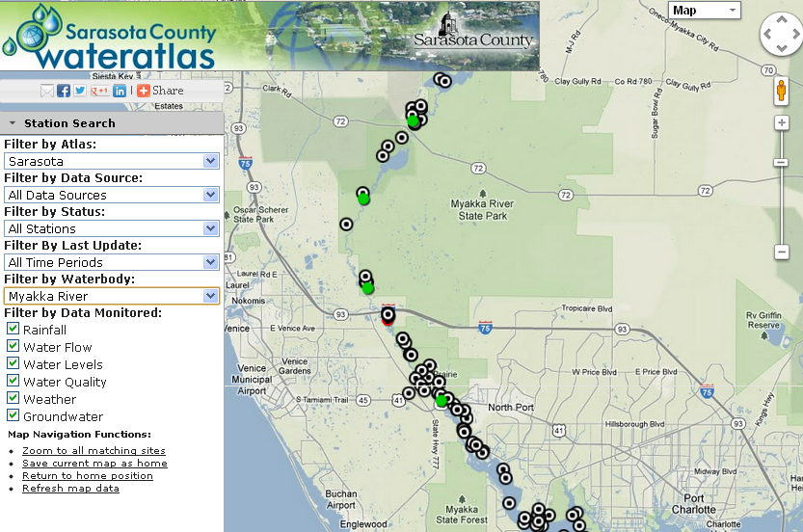
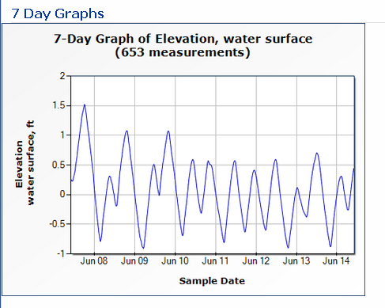
Real-time Data Mapper
Tool for viewing real-time & ambient sample sites/data
Google map-based – can choose map or satellite view, zoom/pan
User can filter stations by atlas, data source, status (active/inactive/ decommissioned), data currency, water body, data monitored
Filtering to a single water body reveals ambient data collection sites
Clicking on site icon opens popup with metadata
Clicking on link in popup allows user to view graphs of most recent data or to download data

Slide 16
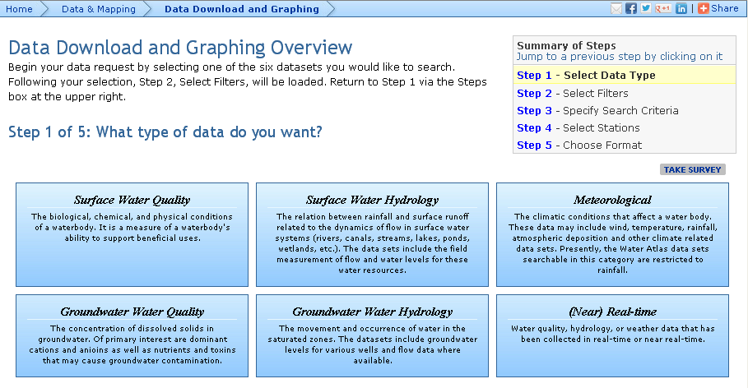
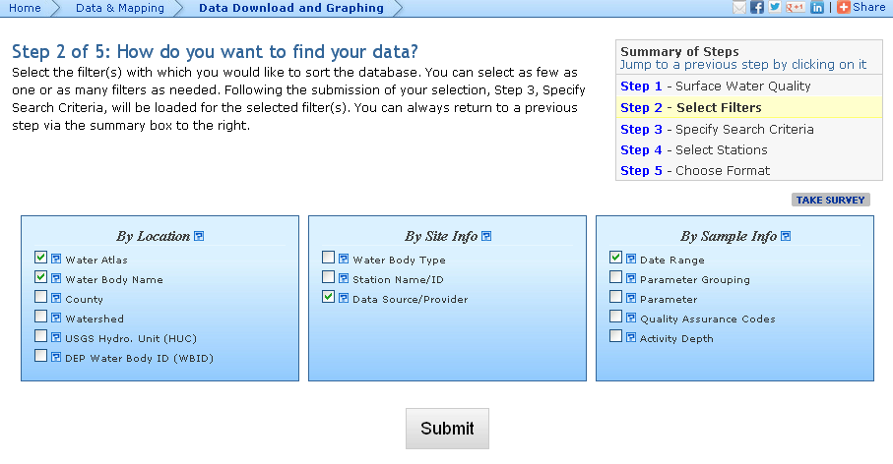
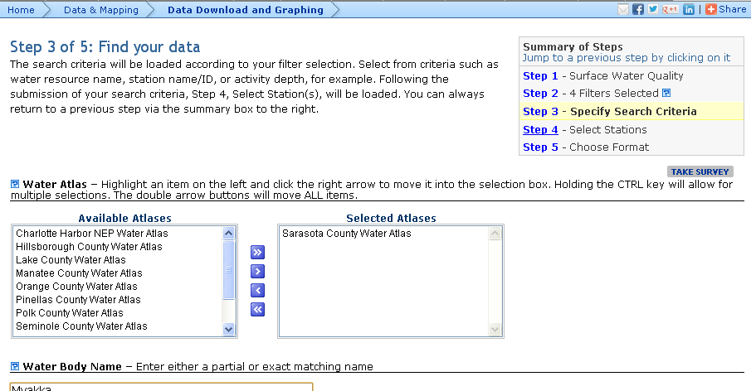
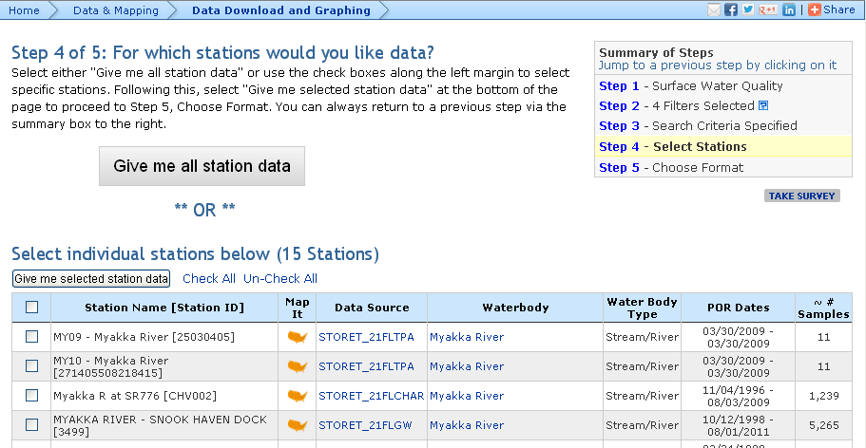
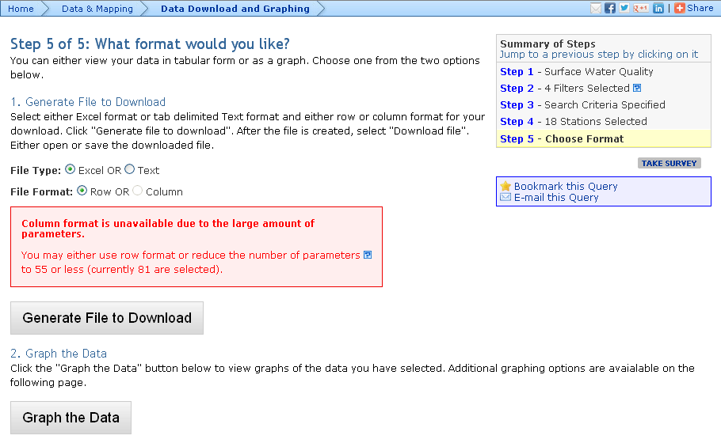
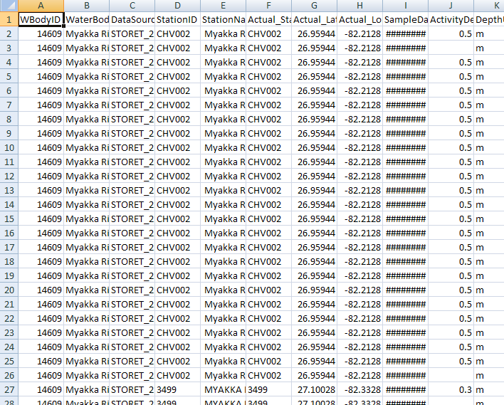
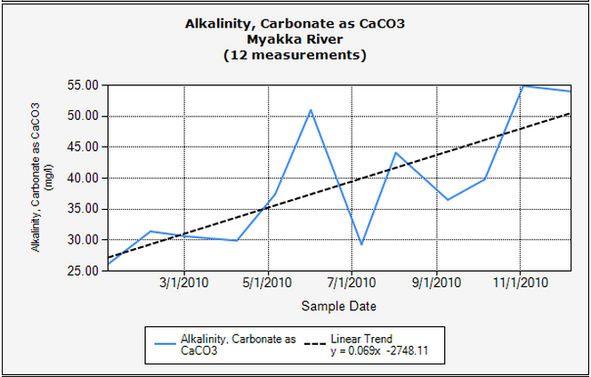
Data Download
Allows user to download & graph water quality, hydrology, and meteorological data from one or more sample sites
User selects candidate sites by filtering on location, site info, sample info
User may choose one or more stations to view
User may download tabular date in row or column format, or view the data as graphs

Slide 17
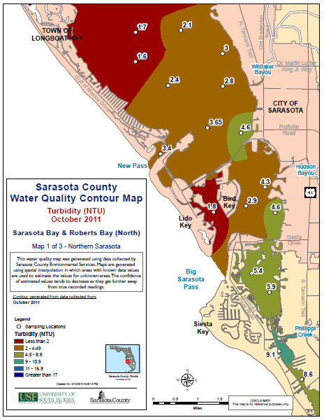
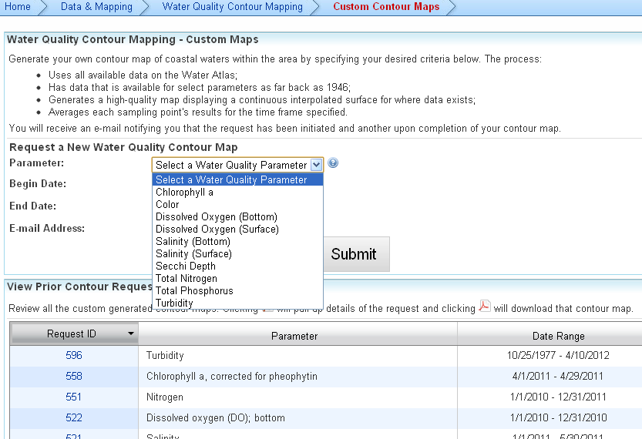
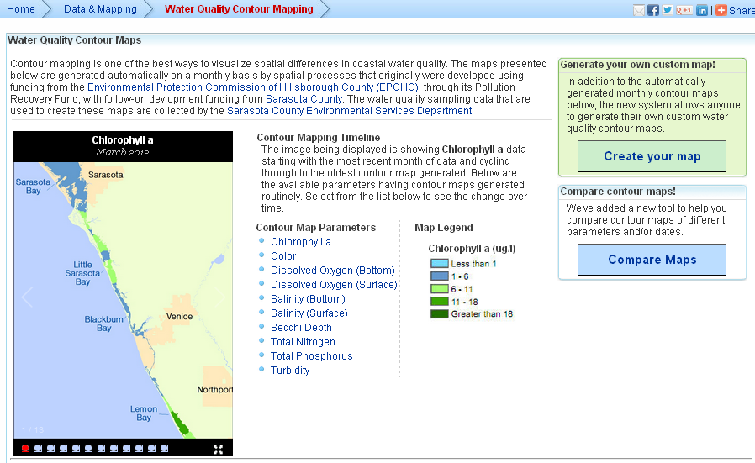
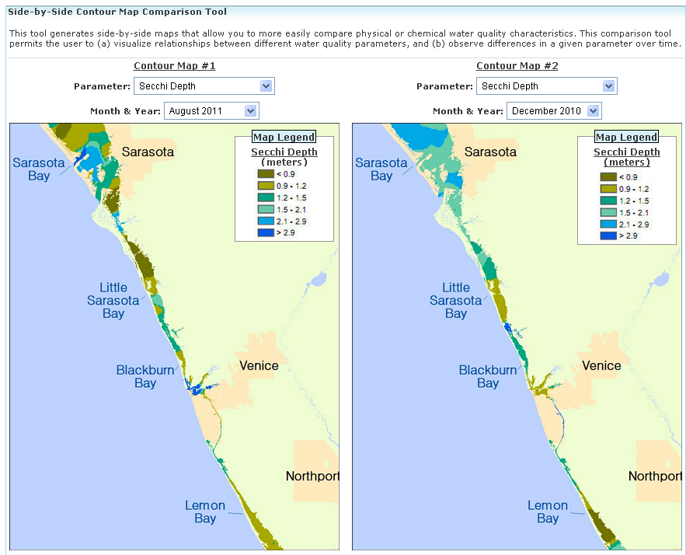
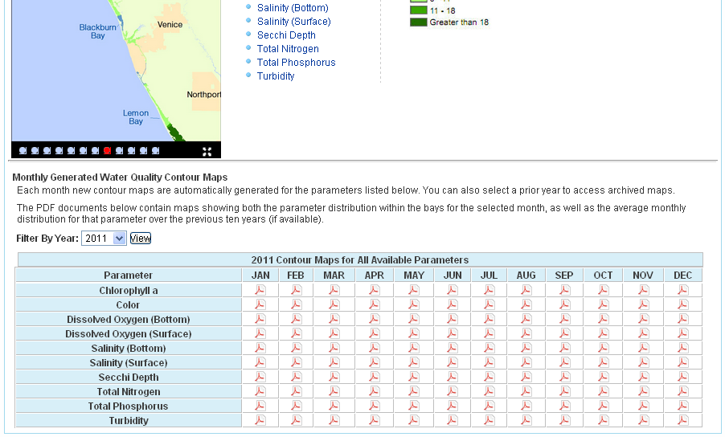
WQ Contour Mapping
Allows spatial visualization of water quality parameter values
Available on coastal atlases for bays
Set of pre-selected WQ parameters may be mapped
Three options:
View stored PDFs created monthly for a single parameter
Compare different parameters and/or months onscreen
Create a custom map by choosing time period, WQ data samples; job is queued, PDF is emailed to user

Slide 18
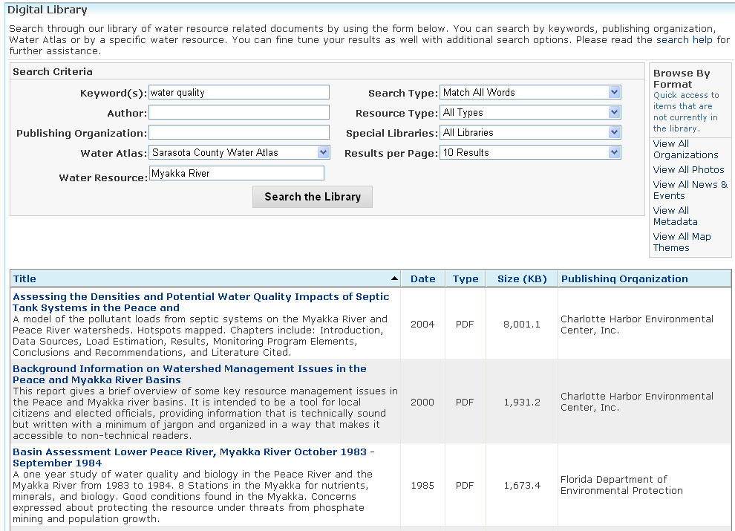
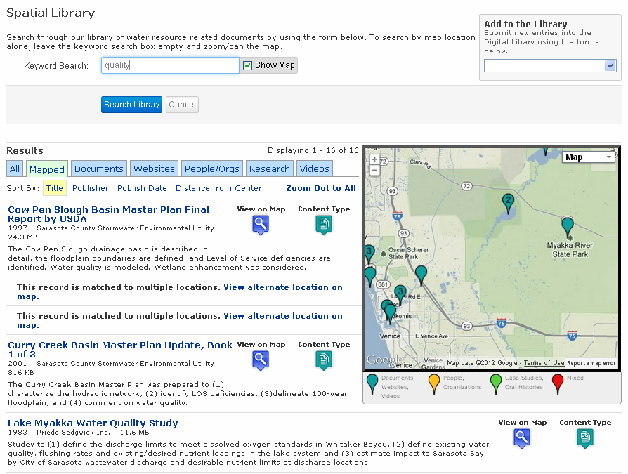
Digital Library
Electronic repository for documents, videos, websites, contact info:
Search by keyword, water resource, map, type, author, publisher
Documents include management plans, water resource assessments, research reports, fact sheets, brochures…
Recently added spatial component to display map with icons for documents linked to particular water resource

Slide 19
An Evolving Project…
New features and tools are constantly under development
As GIS and database technologies improve, so does the Water Atlas
Our sponsors and users constantly find new uses for the Water Atlas
Future enhancements will include more mobile apps
What would you like to use the Water Atlas for? Tell us!

Slide 20
Contact the Water Atlas
If you have questions, comments, suggestions… Please contact:
Jan Allyn, Web Content Manager
janallyn@usf.edu
(813) 579-3381
Follow us on:
@wateratlas, facebook.com/wateratlas
Cool, clear, spatially-mapped data served fresh daily... Drink up!

Slide 21
Questions?

